Slide 1
Go-Fleet
AlgoCodeIT

Slide 2






Introduction
Web and Mobile Development
Delivery Logistics Company

Slide 3
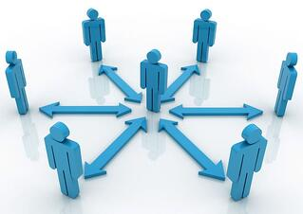


Current System flow
Logistics Manager receives information from consultant and dispatches Information to drivers.
08:00
09:00
10:00
Phaki drivers depart to their set daily destinations.
Client calls Phaki consultant and places order for supplies.
2 Hour Long Process

Slide 4



New System flow timeline(Hypothesis)
Consultant Captures Information from client on Go fleet system.
(One day in advance)
Delivery vehicles get loaded and drivers get ready to depart to destinations.
08:00
08:30
09:00
Manager overviews and approves jobs for the day and Information gets delivered to drivers.
Phaki drivers depart to their set daily destinations.

